Slide 1
COVID-19 Pandemic Dashboard
CoronaWhy Task Time Series Dashboard for determining county spread risk.

Slide 2
Current COVID Model deficiencies
”Unfortunately, today’s state-of-the-art models have the following deficiencies:
Resolution — they work mostly at the country or state level and few are at the county level (let alone city, neighborhood, or block)
Timeliness of data used — they have limited ability to leverage observed data
Model sophistication — at this time, they have limited ability to consider age distributions or socio-economic conditions.”
-D.J. Patil Former U.S. Chief Data Scientist

Slide 3
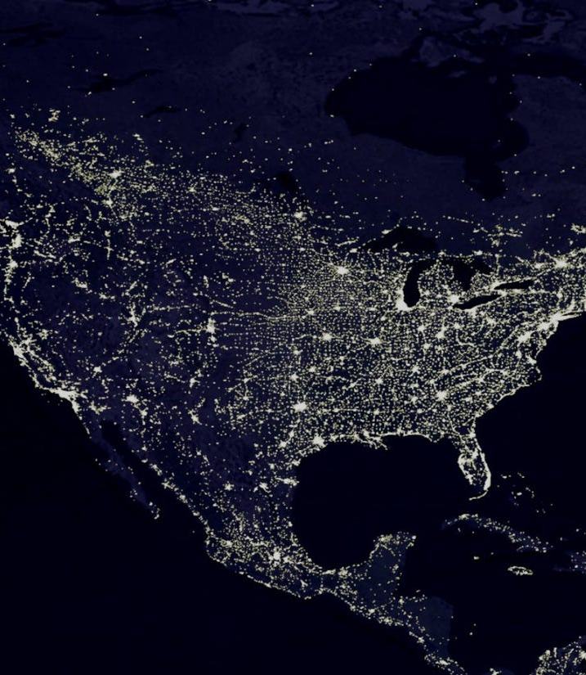
Our COVID Models
COVID-19 projections at the county level (most current models only forecast at state or country level).
Model forecasts updated daily with most recent COVID-19 data and are retrained on a weekly basis on new data.
Final models will incorporate demographic, geo-spatial, social media, weather, mask usage and mobility data.

Slide 4
What the dashboard will contain
Key questions our dashboard aims to answers
What will your county hospitalizations and case counts look like 16 days from now?
What will my county case numbers look like if we took the following actions?
Which factors are driving the COVID-19 spread (or lack thereof) in the community?
Historically, if my county had done x what would our case numbers/hospitalizations be?
Show a county wide warning if projected number of hospital beds crosses 100%..
Forecasted foot traffic/trends in mobility?
Highest risks of super spreader events.
See early indicators of virus spreading in certain counties along with current county rankings in terms of key metrics.
Valuable for epidemiologists, public policy officials, business owners, and others concerned about the virus.

Slide 5
Main methodology: A high level overview
Synthesize large amount of COVID-19 data sources into a central queryable data lake.
Utilize custom interpretable machine learning architectures based on latest research in many areas of data science.
Select best models based both on evaluation metrics and opinion of domain experts.
Multi-disciplinary team consisting of experts in time series forecasting, representation learning, computer vision, data engineering , data visualization, and epidemiology.

Slide 6
Data Sources
Currently Utilized Sources of Data
Official Case/Hospitalization data
Mobility data general (i.e. parks, retail, recreation, workplace)
Data Sources Collected and actively incorporating
Weather data
Symptom surveys (BEAT-19)
County level intervention data
Demographic and county level geo-spatial meta-data
Data in roadmap to collect
Twitter data
Delphi data (doctor’s visits, FB symptom surveys, etc)
Google Search trends data
Granular mobility data (broken down by bars, restaurants)
Super spreader events data

Slide 7
Forecasting Approaches
Modified Transformer model with a simple decoder (custom model not yet published)
Dual-Stage Attention-Based Recurrent Neural Net for Time Series Prediction (Qin et al 2017) + additional dropout
Dual self attention for multivariate forecasting (Huan et al 2019) + additional dropout
Temporal Fusion Transformers (Lim et al 2019) + additional dropout

Slide 8
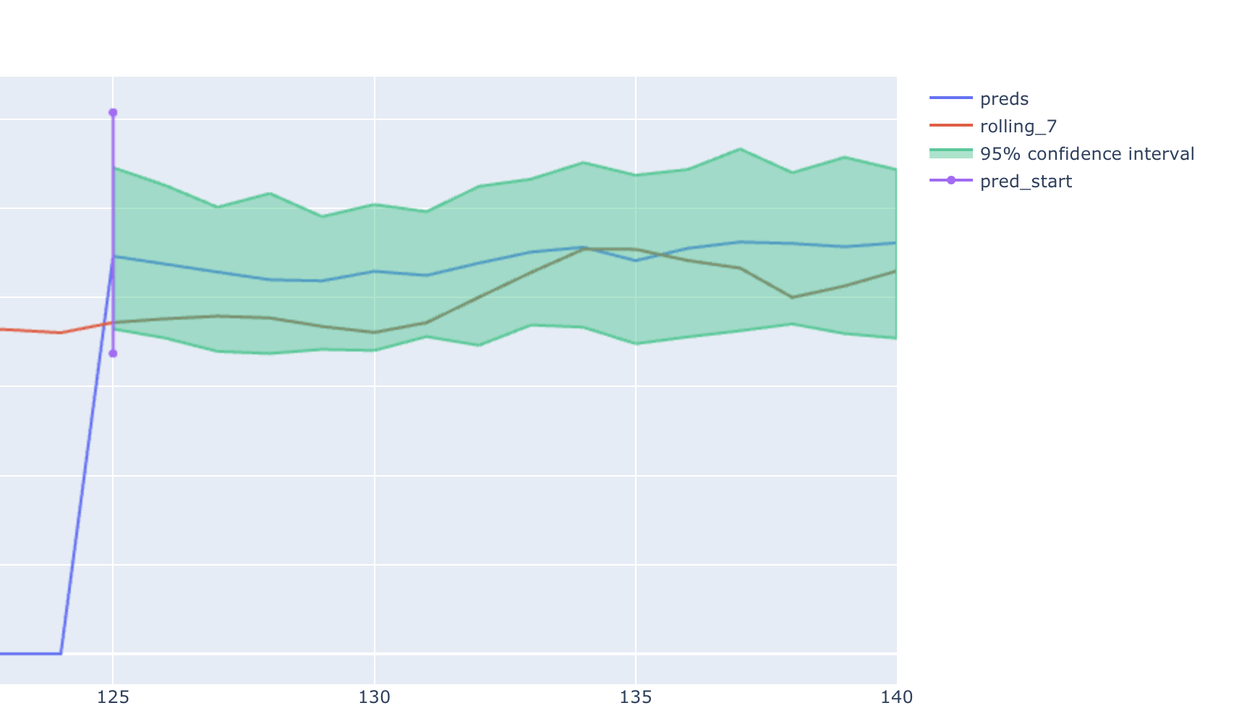
Example result: Cook County IL
Entire 16 day
forecast in
confidence interval
using just mobility
and case data!

Slide 9
COVID Forecasting: A summary
COVID is an extremely complex problem to forecast! It requires:
Joining many different data sources to capture the nuances of spread.
Leveraging the latest techniques in computer vision and representation learning to form good county representations.
Finding good time series models that can generalize to out of distribution events.
Utilizing the latest research in multi-model fusion to fuse county representations with temporal.
Having domain experts to evaluate the quality of learned models.
However, we have a skilled team of both time series and ML experts as well as domain experts.

Slide 10
Further resources
Team Roster
Towards Data Science Article on Task Time Series (detailed)
Experiments and Results on Weights and Biases
Full list of CoronaWhy Task Time Series deliverables
CoronaWhy Main Website
Task Time Series Wiki Page

